Slide 1
Railway Ticket Reservation System
Software Engineering – Requirement Engineering
Group 6

Slide 2
Group Members
Ch. Arsalan Ali Daim BSCS14068
H.M. Abdul Wajid BSCS14054
Azhar Ali BSCS14058
Danish Javed BSCS14028

Slide 3
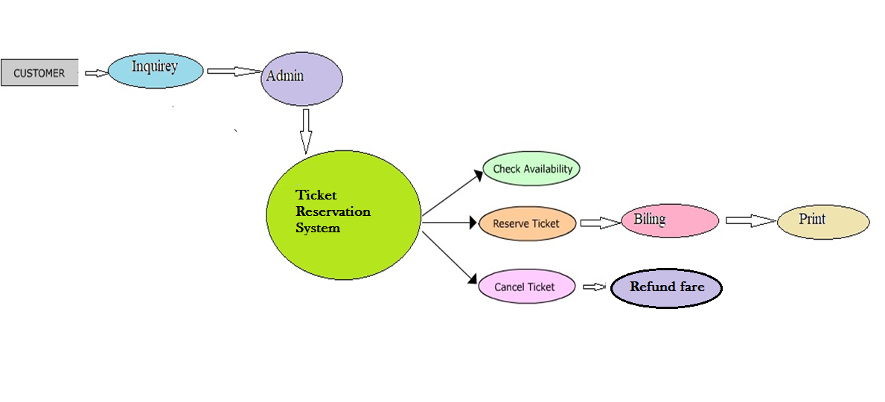
Abstract view of Software

Slide 4
Techniques
Ethnography
People come to buy ticket at the station and what is the procedure followed by the operator?
Use Case
Source → Destination → Available Train → Which Coach Passenger wants? → Amount of seat? → Issued
What if he wants to cancel?
Search Record → Found or not? → if yes, Cancel the booking → Record Deleted → Mark if amount is returned back to passenger?

Slide 5
Functional Requirements (1)
A Desktop Application
System will provide “Operator Login” functionality
System should generate a unique identification No. for each passenger that is to differentiate between passengers with similar bio-data.
System should generate daily report of ticket booking and cancelation

Slide 6
Functional Requirements (2)
Operator will be able to:
See available trains and their arrival and departure time.
Number of seats, coaches, berths, either available or not, in each train.
Select the train according to the destination of the passenger.
Search the vacancy of passengers in the train according to the coaches.
Differentiate the coaches of the train.
Issue the ticket to passengers according to the ticket’s category or passenger’s requirement.
Bill the passenger for the issued ticket and balance the residual amount with return.
Cancel the ticket according to railway rules, if the passenger asks to do so.
Fare refund in case of cancellation.
Monthly report of tickets booking and cancelation

Slide 7
Non-Functional Requirements Product Requirements
Response Time of system Transactions and Searching should be less because it’s a real-time application and its response time depends upon performance and space. So, in short system should be efficient.
Also, System should be easy to use and there should be no data redundancy.
System shall give a good User Interface to easily see the output.

Slide 8
Non-Functional Requirements Organizational Requirements
User or operator should authenticate himself to access the software by login procedure.

Slide 9
Non-Functional Requirements External Requirements
Passenger’s information should be secure in the software. The ways to access information should be secure and the information shall only be accessed through the system.

Slide 10
Metrices for Non-Functional Requirements
Speed
Response time for transections of data
Maximum Time for a transaction should be less than 2 seconds.
This would require use of best algorithms and efficient coding
Size
How much Mbytes it take to store each data by knowing how much bytes have given for a passenger
Ease of use
User Interface & understandability of operator
By making prototypes
Taking Feedbacks
Reliability
Rate of failures when requested to save information
By Making Use cases

Slide 11
Requirements Validation
Consistency
There is no conflict with requirements
Realism
All the requirements can be achieved. Using C# Desktop Application will result us with all requirements
Verifiability Check
Prototypes
Test Case Generation

Slide 12
THANK YOU

